Slide 1
Modelling Camp
Earth observation
Group 4

Slide 2
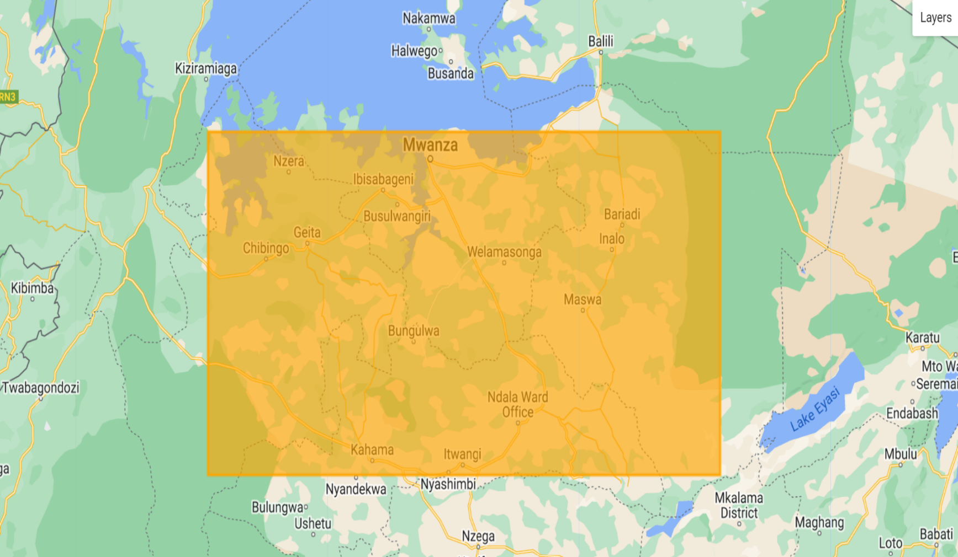
Data Pre-processing
Row data:
longitude, latitude, PH
Two Sentinel-2 images (23 channels at regular grids) from 250m and 30m resolutions (4938 obs).
For each observation, find the corresponding covariate values in 23 channels by looking for the closest grid, in terms of Euclidean distance.

Slide 3
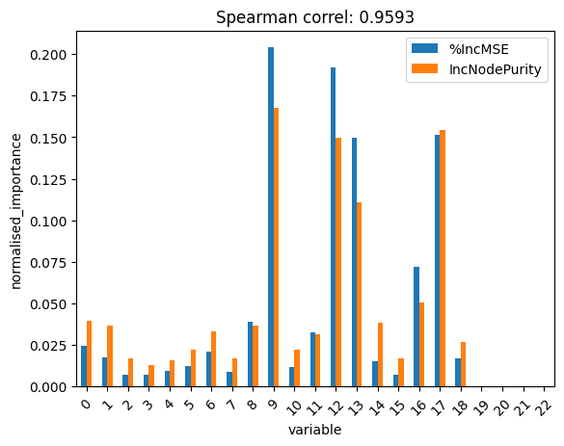
Ensemble machine learning – Random forests
Training data: 70%
Out-of-bag error for hyperparameter tunning
Variable importance:
B9 (Water vapor)
AOT (Aerosol optical thickness)
WVP (Water vapor pressure)
TCI_B (True color image, blue channel)
TCI_G (True color image, green channel)
Refit with top 5 variables and B4 (important in the main reference)

Slide 4
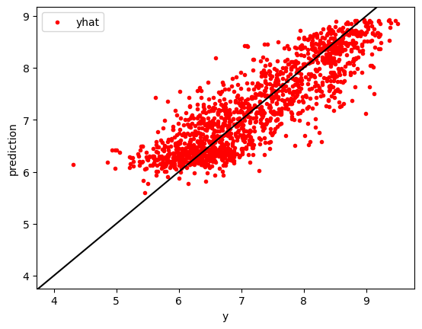
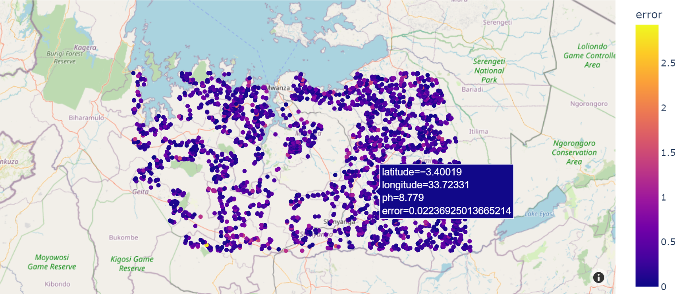
Mean squared error (MSE) for test data: 0.334
Predicted PH for the whole data

Slide 5
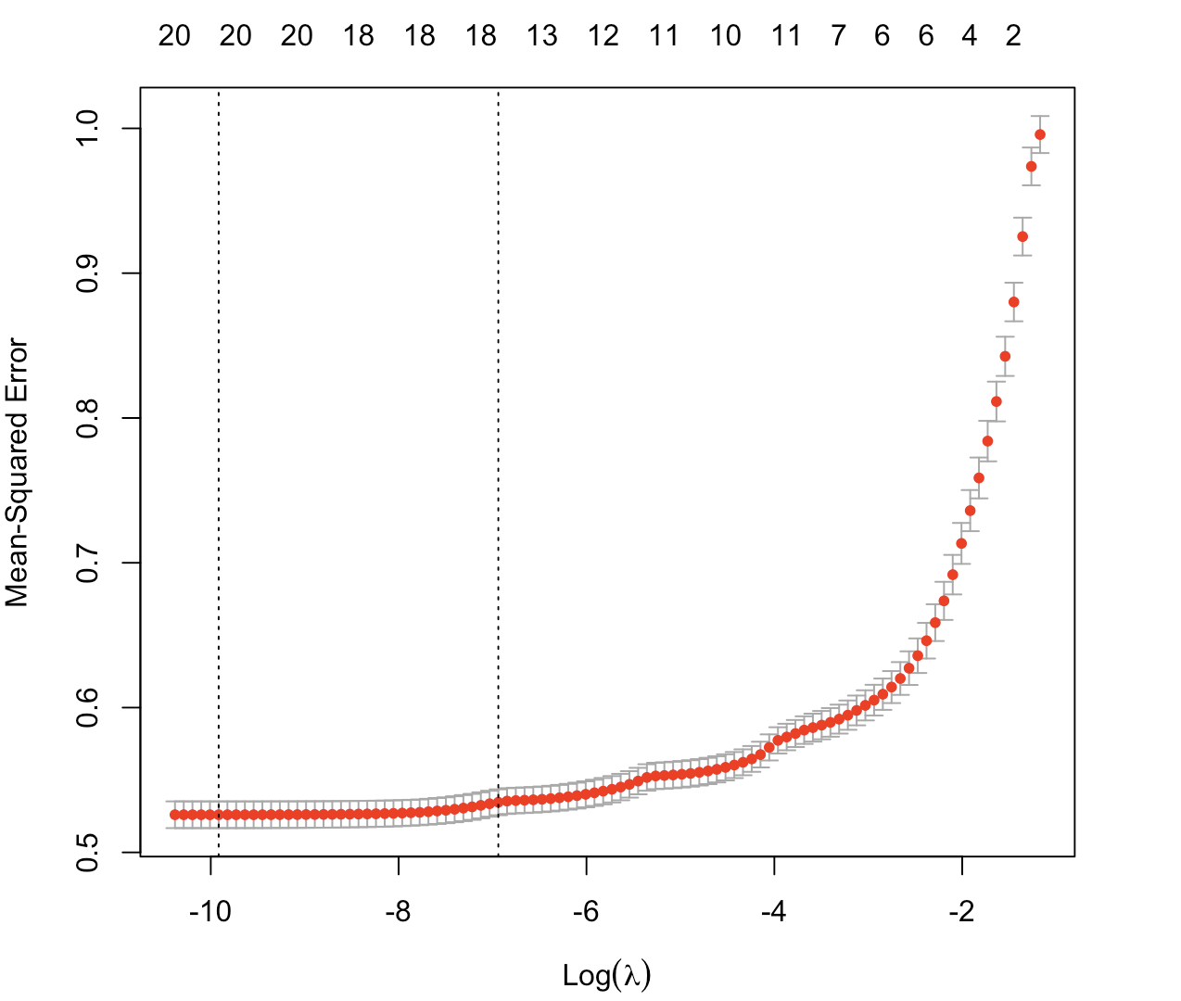
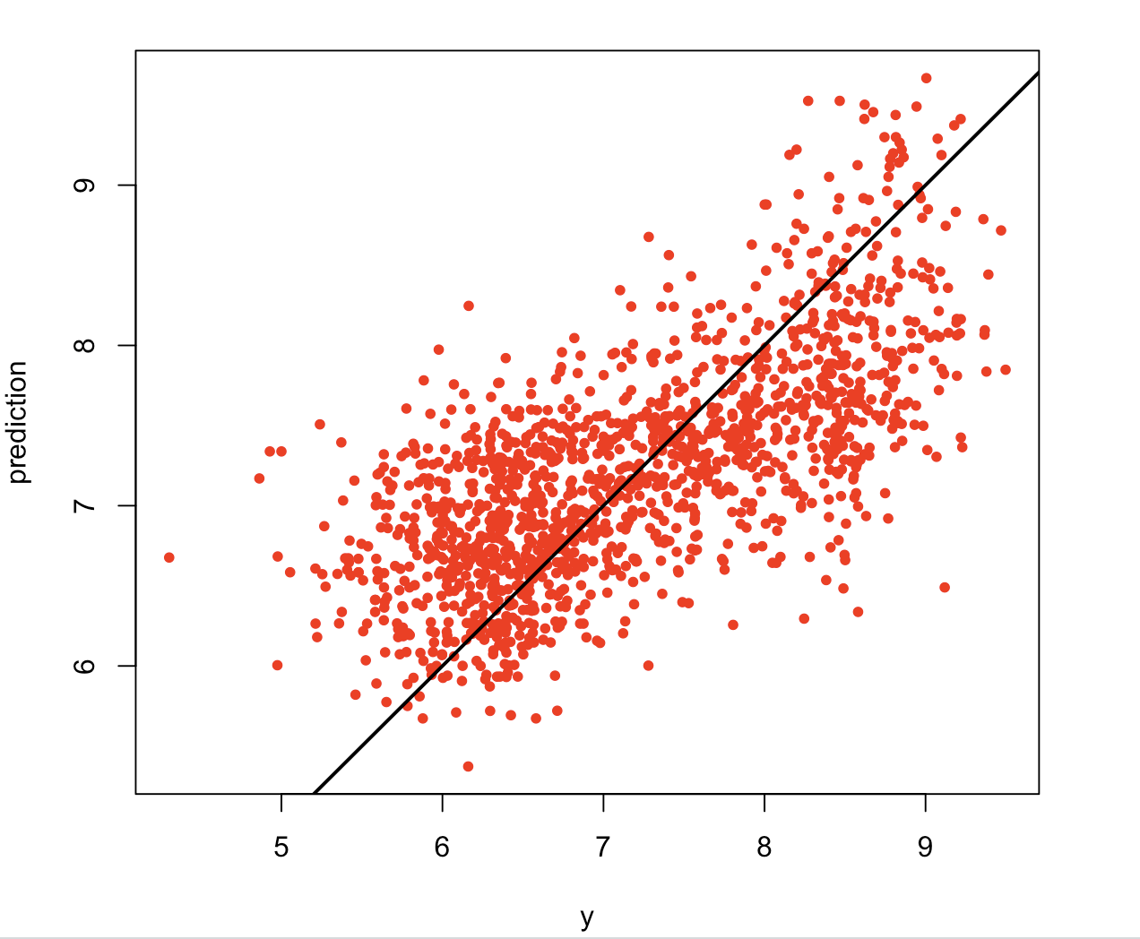
Ensemble machine learning – GLM with lasso
Same training data as RF
10-fold cross validation for hyperparameter tunning
Compared to RF, one more variable is included: MSK_SNWPRB (Snow probability map)
MSE for test data: 0.532

Slide 6
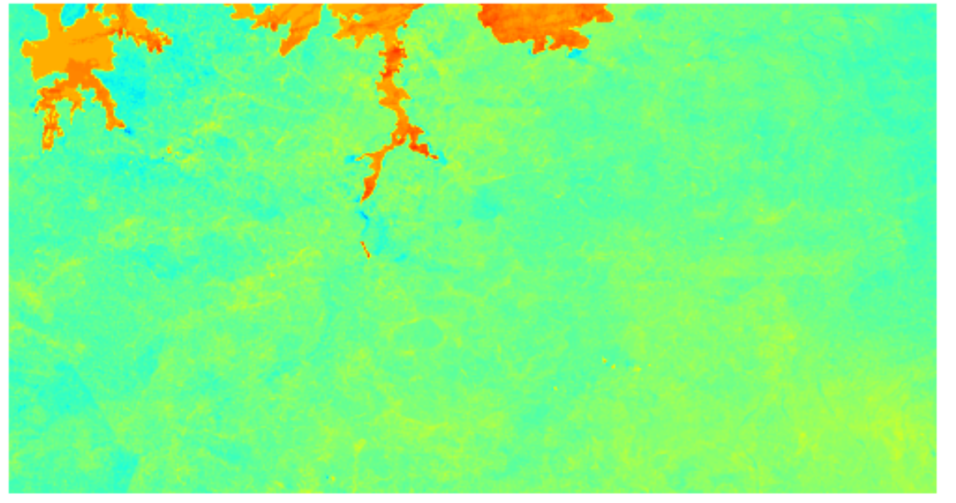
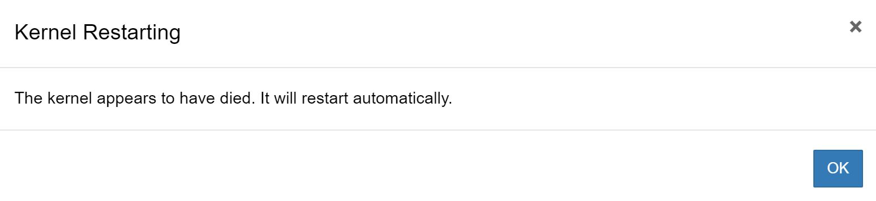
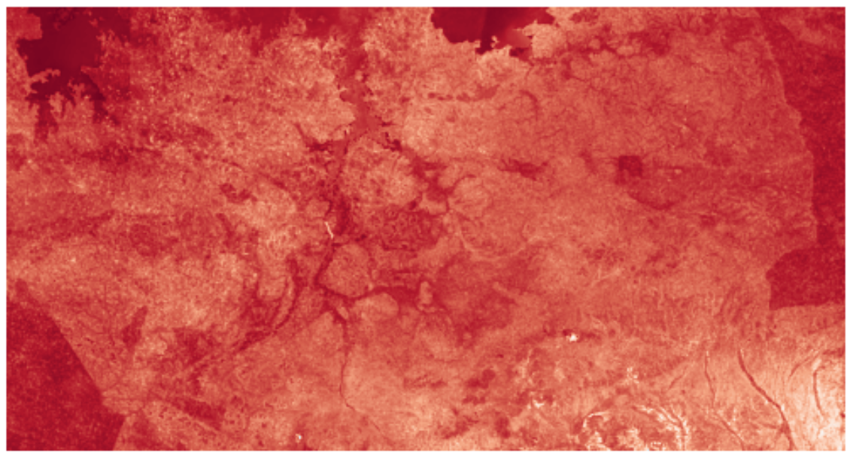
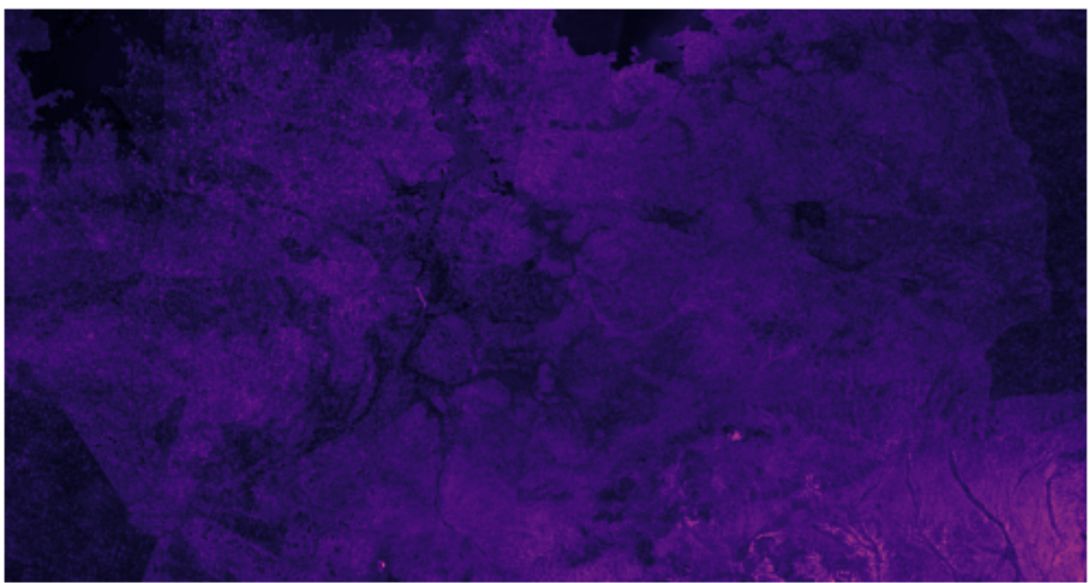
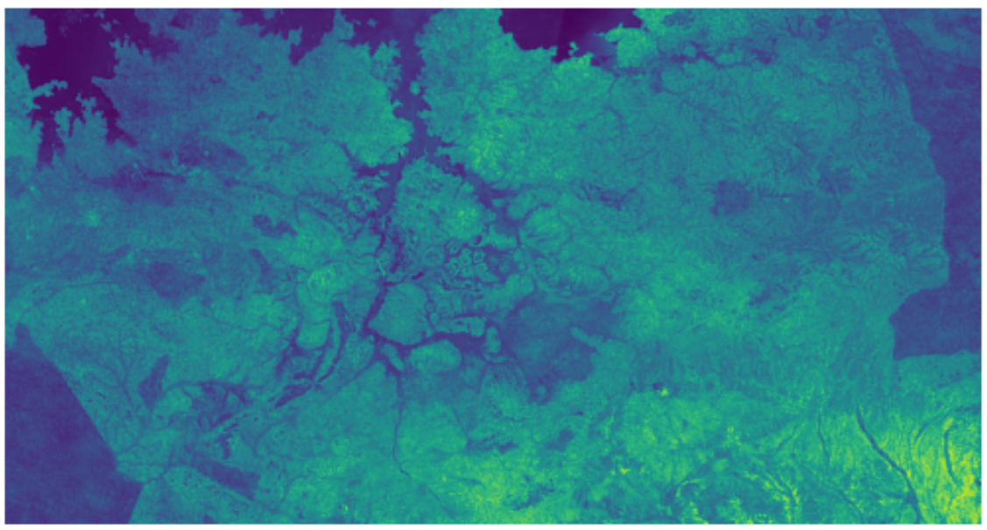
A convoluted approach
CNN

Slide 7

Future works
XGboost
Combine the predictions from all the implemented models
Convolutional neural network

